Slide 1
CS 4530: Fundamentals of Software Engineering Module 12.2: Beyond Unit Testing
Adeel Bhutta, Mitch Wand
Khoury College of Computer Sciences
© 2023 Released under the CC BY-SA license

Slide 2
Learning Objectives for this Lesson
By the end of this lesson, you should be prepared to:
Explain why you might need tests that are larger than unit tests
Explain why you should or shouldn’t use a mock in conjunction with these larger tests.
Explain how large, deployed systems lead to additional testing challenges

Slide 3
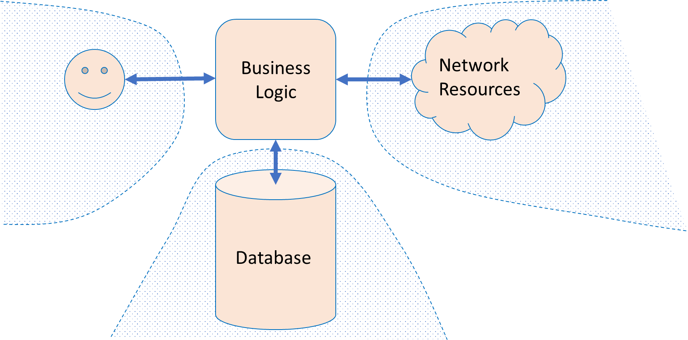
Large Systems are Hard to Test
Database component
Contents may need to reflect/simulate real-world;
Data may be expensive/proprietary/confidential.
Network connections
"Real" connections may be slow/flaky/disrupted;
Resources may have changed since test was written.
Environment
Interactions with OS, locale or other software.
Human actors
Ultimately unpredictable.
Specifications are incomplete, and may change
Large systems -> many behaviors/interactions to consider
Specifications may evolve over time
Notes:
Let’s talk about some of the complexities of larger systems
<read slide>

Slide 4
Test doubles can help.
To create "small" tests that are faster and less flaky
Example: Testing a unit that processes result of an external API call; only interested in testing what happens after the external call returns
When the real thing is unavailable
Example: Integrating with external vendors
When testing for unusual or exceptional cases that are hard to make happen in practice
Example: when external service fails in the middle of a transaction
Notes:
Test doubles are used in many situations!

Slide 5
Mocks and fakes can sometimes help.
Sometimes called a fake, these mocks have an implementation of the object being replaced
A low-fidelity fake implements things partially
Enough to work for the test.
A high-fidelity fake implements most aspects:
Usually all functional aspects;
Usually not as efficiently or as scalable.
The purpose of this mock is to avoid processes/network/cost, but still perform some activities
Create fakes in Jest with mock.mockImplementation(…)
Fake has
"semi-real implementation"
Notes:
Fake objects actually have working implementations, but usually take some shortcut which makes them not suitable for production (an in memory database is a good example).
A fake is a simpler implementation of real objects. For example, our transcript databases are fakes-- they are a simple implementation of a "real" database, which might be external, etc.

Slide 6
Test Doubles Have Weaknesses
Some failures may occur purely at the integration between components:
The test may assume wrong behavior (wrongly encoded by mock)
Higher fidelity mocks can help, but still just a snapshot of the real world
Test doubles can be brittle:
Spies expect a particular usage of the test double;
The test is "brittle" because it depends on internal behavior of SUT;
Potential maintenance burden: as SUT evolves, mocks must evolve.
We already saw this in the preceding lesson
Notes:
<read slide>

Slide 7


But some bugs are observable only when multiple components interact.
These are usually because one module has made incorrect assumptions about some other module
Unit tests won’t reveal such bugs
Mocks won’t help, either (since they may incorporate our incorrect assumptions)
So you really need integration tests
Integration
Unit
Mork
1 program running on 1 server
1 class of 1 program running on 1 server
Notes:
So far, our focus has been on writing on unit tests, which focus on a single module or class.
Many bugs may be observable only when multiple components interact (often as a result of one making an incorrect assumption about the others’ behavior).
To find these bugs, we may need to create bigger tests. These are generally called integration tests.

Slide 8

Integration tests may be larger
Does the presence of other jobs on our server change the behavior of our program?
Does the presence of the other servers change the behavior of our program?
Integration
Unit
Mork
1 web server in a cluster of 100,000 servers
1 program running on 1 server
1 class of 1 program running on 1 server
Notes:
For instance, our SUT might actually consist of multiple processes running in coordination on a single server.
Or maybe we need to worry about what happens when we run it on a live server, running alongside other servers in a cluster of 100’s of thousands of servers.

Slide 9
Some Tests are Enormous
Integration
Unit
Mork
1 class of one program running on a web server
1 Google product in the entire Google ecosystem
1 web server in a cluster of 100,000
1 process running on a web server
Notes:
Or, maybe our focus is on testing the end-to-end behavior of an entire product, which is composed of many classes running in many processes on many servers. As you can see, the scope of integration tests can grow enormously.

Slide 10
Google classifies tests by “size”
"Large"
Integration
Unit
"Medium"
"Small"
Mork
1 class of one program running on a web server
1 Google product in the entire Google ecosystem
1 web server in a cluster of 100,000
1 process running on a web server
“small” = single process
“medium” = single machine
“large” = bigger than that.
"Software Engineering at Google: Lessons Learned from Programming Over Time," Wright, Winters and Manshreck, 2020 (O’Reilly)
Notes:
The lens that we will use to discuss testing strategies for large systems is "test size," a strategy used within Google: classify tests into a size and encourage engineers to always write the smallest possible test for a given piece of functionality. Test size is based on what it is allowed to do, and how many resources it consumes.
small tests run in a single process, medium tests run on a single machine, and large tests run wherever they want. Small tests, regardless of the scope, are almost always faster and more reliable than tests that involve more infrastructure or consume more resources. More can go wrong if you have to spin up entire VMs in the middle of your test.

Slide 11
How big is my test?
Small: run in a single thread, can’t sleep, perform I/O or make blocking calls
Medium: run on single computer, can use processes/threads, perform I/O, but only contact localhost
Large: Everything else
"Software Engineering at Google: Lessons Learned from Programming Over Time," Wright, Winters and Manshreck, 2020 (O’Reilly)
Notes:
Small tests are structured to be fastest, most reliable. This becomes important if you want to run your tests a lot, like if you have ten thousand developers running tests 24/7. Similar to traditional unit testing.
Medium can do lots of stuff, but note importance of not connecting to other servers. This is so your entire test is self contained.
Large is everything else. These can be slowest to run and most fragile. Imagine you are testing connecting to a remote server, and sometimes it’s slow, or the canonical distributed systems example of an intern tripping over a cable. So, speaking of fragile.

Slide 12


Testing Distribution (How much of each kind of testing we should do?)
Pyramid
Test Pattern
From SoftEng @ Google Chapter 11
https://learning.oreilly.com/library/view/software-engineering-at/9781492082781/ch11.html#testing_overview
Notes:
Typically we talk about this ice cream cone where we have a lot of a lot of manual tests, and then some automatic automated tests specifically related to GUI and then some integration tests and unit tests. The book that we mentioned earlier, software engineering at Google, recommends a different paradigm. It recommends that about 80% of your testing should be focused on unit testing and then about 15% on integration testing and then about 5% on end to end testing (what is known as system level testing).

Slide 13
Deployed systems create even more testing challenges
Clients believe “how it is now is right”,
Not “how the API intended it to be is right”
Writing thorough test suite is even harder, less useful
What is a “breaking change”?
Still: vital to detect breaking changes
Examples:
Detailed layout of GUIs
Side-effects of APIs, particularly under corner-cases
Notes:
Testing larger systems may get more complicated. How do you automatically check for breaking changes and updates to GUI layout?
<Read slide>
If we move a button, is that a breaking change? Do our clients rely on the *exact* position of that button?

Slide 14
Snapshot Tests Can Detect GUI Changes
The first time the test runs, it saves a "snapshot" of the rendered GUI
Subsequent runs will fail if the snapshot changes
import renderer from 'react-test-renderer';
import Link from '../Link';
it('renders correctly', () => {
const tree = renderer
.create(<Link page="http://www.facebook.com">Facebook</Link>)
.toJSON();
expect(tree).toMatchSnapshot();
});
Notes:
<Maybe just read text of slide>
(Read slide. Code on left is the test, on right is what happens after running the test to save the snapshot, then changing Facebook to instagram)
This test might have a "false positive" in that it will fail for any change, and not just a bug. However, if changes are relatively infrequent, and changes would require updating the test anyway (e.g. changing the test to say instagram instead of Facebook ), then at least the test is now fully automated, and doesn’t need manual repair!

Slide 15
Capture/replay can detect breaking changes in API endpoints
Record the API requests and responses that clients make
Test new versions of the API by identifying requests that result in different responses ("breaking changes")
Current version of API
Clients (created by many third parties)
Capture/Replay Proxy for Testing
Production traffic
Production traffic
Next version of API
Replay production traffic for testing
https://www.tradeweb.com/our-markets/data--reporting/replay-service/
Notes:
Capture/replay can also be used as a testing strategy when building large, complex APIs. Consider the case where we are building (your favorite API…stripe/shopify/twilio/linkedin/Facebook/whatever). We do our best to specify clearly what clients should expect of our API. However, it is surely impossible to specify all possible behaviors, and clients may rely on invalid assumptions about our specification.
Hence, it’s often extremely important, as the developer of that API, to test for and detect breaking changes before making a release. If your biggest clients are going to have a problem using the new version of your API, you should probably detect this and let them know, before they are the ones who figure it out.
With this approach, we create, effectively, a mock for all (or some) of our clients by capturing all of the requests and responses. We can then replay that API traffic against the new version of our API under development to detect breaking changes.
Of course, replaying API traffic might have some side-effects, too (imagine replaying the traffic of a payment processor, and in doing so making duplicate payments!). Doing this well requires a complex testing environment, where we might also have other mocks that isolate this testing environment from all of the production services.
Example: TradeWeb ReplayService™: a testing platform for financial market data applications
Originally a product of Thomson Reuters (data provider), then spun off to CodeStreet, then acquired by TradeWeb https://www.tradeweb.com/our-markets/data--reporting/replay-service/

Slide 16
Review: Learning Objectives for this Lesson
You should now be able to:
Explain why you might need tests that are larger than unit tests
Explain why you should or shouldn’t use a mock in conjunction with these larger tests.
Explain how large, deployed systems lead to additional testing challenges

